Slide 1
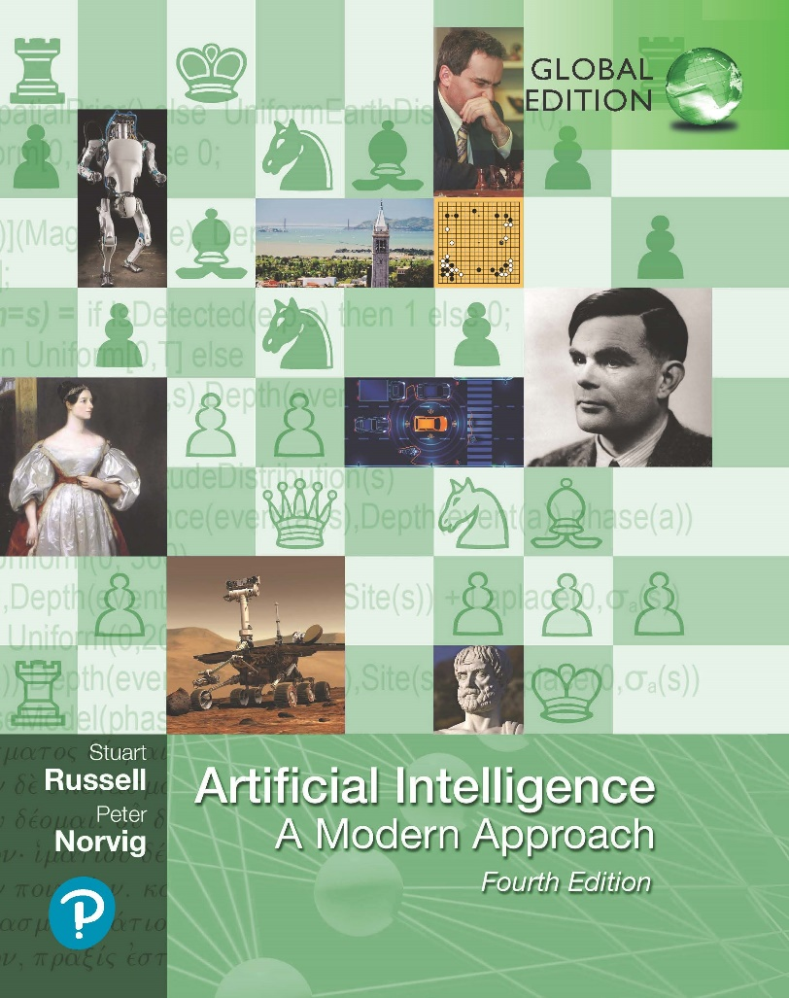
Artificial Intelligence: A Modern Approach
Fourth Edition, Global Edition
Chapter 10
Knowledge Representation
© 2022 Pearson Education Ltd.

Slide 2
Outline
Ontological Engineering
Categories and Objects
Events
Mental Objects and Modal Logic
Reasoning Systems for Categories
Reasoning with Default Information
© 2022 Pearson Education Ltd.

Slide 3
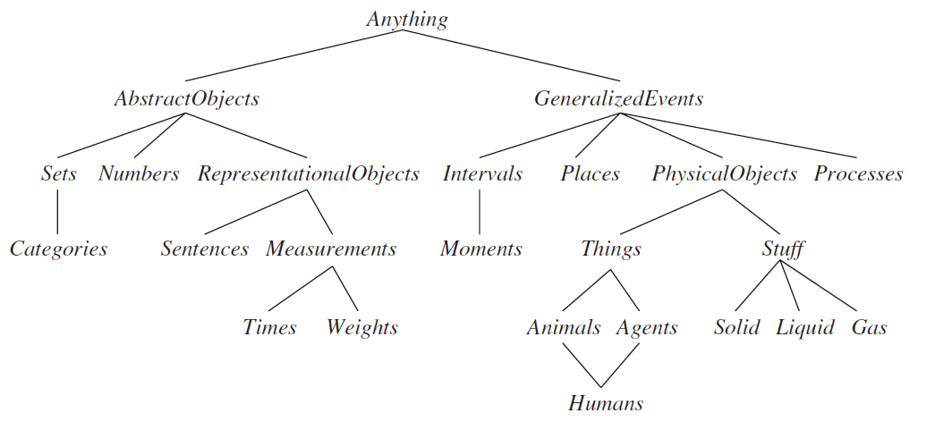
Ontological Engineering
Ontological Engineering: General and flexible representations for complex domains.
Upper ontology: The general framework of concepts
Example of ontology of the world:
© 2022 Pearson Education Ltd.

Slide 4
Categories and Objects
The organization of objects into categories is a vital part of knowledge representation
Categories for FOL can be represented by predicates and objects.
Physical composition: one object can be part of another is a familiar one
Eg: Romania is part of Bucharest. PartOf(Bucharest, Romania)
Measurements: values that we assign for properties of objects
Eg: Length(L₁)=Inches(1.5)=Centimeters(3.81)
© 2022 Pearson Education Ltd.

Slide 5
Categories and Objects
Stuff: a significant portion of reality that seems to defy any obvious individuation—division into distinct objects
Intrinsic: they belong to the very substance of the object, rather than to the object as a whole.
Extrinsic: weight, length, shape
Substance: a category of objects that includes in its definition only intrinsic properties (mass noun).
Count noun: class that includes any extrinsic properties
© 2022 Pearson Education Ltd.

Slide 6
Events
Event calculus: events, fluents, and time points
Fluents (eg): At(Shankar, Berkeley)
Events (eg): Event E₁ of Shankar flying from San Francisco to DC
E₁ ∈ Flyings ∧ Flyer (E₁, Shankar) ∧ Origin(E₁, SF) ∧ Destination(E₁, DC)
Flyings is the category of all flying events.
Categories for FOL can be represented by predicates and objects.
Physical composition: one object can be part of another is a familiar one
Eg: Romania is part of Bucharest. PartOf(Bucharest, Romania)
Measurements: values that we assign for properties of objects
Eg: Length(L₁)=Inches(1.5)=Centimeters(3.81)
© 2022 Pearson Education Ltd.

Slide 7
Mental Objects and Modal Logic
Mental objects are knowledge in someone’s head (or KB)
Propositional attitudes that an agent can have toward mental objects
Eg: Believes, Knows, Wants, and Informs
Lois knows that Superman can fly:
Knows(Lois, CanFly(Superman))
Sentences can sometimes be verbose and clumsy. Regular logic is concerned with a single modality, the modality of truth.
Modal logic addresses this, with special modal operators that take sentences (rather than terms) as arguments
“A knows P” is represented with the notation K_{A}P, where K is the modal operator
for knowledge. It takes two arguments, an agent (written as the subscript) and a sentence.
The syntax of modal logic is the same as first-order logic, except that sentences can also be formed with modal operators
© 2022 Pearson Education Ltd.

Slide 8
Mental Objects and Modal Logic
Agents are able to draw conclusions. If an agent knows P and knows that P
implies Q, then the agent knows Q:
(K_{a}P ∧ K_{a}(P ⇒ Q)) ⇒ K_{a}Q
Logical agents (but not all people) are able to introspect on their own knowledge.
If they know something, then they know that they know it:
K_{a}P ⇒ K_{a} (K_{a}P)
© 2022 Pearson Education Ltd.

Slide 9
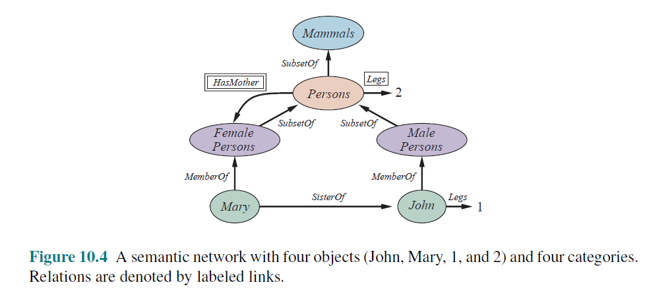
Reasoning Systems for Categories
Semantic networks
convenient to perform inheritance reasoning
Eg: Mary inherits the property of having two legs. Thus, to find out how many legs Mary has, the inheritance algorithm follows the MemberOf link from Mary to the category she belongs to and then follows SubsetOf links up the hierarchy until it finds a category for which there is a boxed Legs link
© 2022 Pearson Education Ltd.

Slide 10
Reasoning Systems for Categories
Description logics
notations that are designed to make it easier to describe definitions and properties of categories
evolved from semantic networks in response to pressure to formalize what the networks mean while retaining the emphasis on taxonomic structure as an organizing principle
Principal inference tasks:
Subsumption: checking if one category is a subset of another by comparing their definitions
Classification: checking whether an object belongs to a category
The CLASSIC language (Borgida et al., 1989) is a typical description logic
Eg: bachelors are unmarried adult males
Bachelor = And(Unmarried, Adult, Male)
© 2022 Pearson Education Ltd.

Slide 11
Reasoning with Default Information
Circumscription and default logic
Circumscription can be seen as a more powerful and precise version of the closed-world assumption.
Specify particular predicates that are assumed to be “as false as possible”
It is an example of a model preference logic
Default logic is a formalism in which default rules can be written to generate contingent nonmonotonic conclusions
Eg: Bird(x) : Flies(x)/Flies(x)
This rule means that if Bird(x) is true, and if Flies(x) is consistent with the knowledge base, then Flies(x) may be concluded by default.
© 2022 Pearson Education Ltd.

Slide 12
Reasoning with Default Information
Truth maintenance systems
Belief revision: inferred facts will turn out to be wrong and will have to be retracted in
Truth maintenance systems, or TMSs, are designed to handle complications of any additional sentences that inferred from a wrong sentence.
Justification-based truth maintenance system (JTMS)
Each sentence in the knowledge base is annotated with a justification consisting of the set of sentences from which it was inferred
Justifications make retraction efficient
Assumes that sentences that are considered once will probably be considered again
© 2022 Pearson Education Ltd.

Slide 13
Summary
Upper ontology based on categories and the event calculus
Special-purpose representation systems, such as semantic networks and description logics, have been devised to help in organizing a hierarchy of categories
Nonmonotonic logics, such as circumscription and default logic, are intended to capture default reasoning in general.
Truth maintenance systems handle knowledge updates and revisions efficiently

